Slide 1

Guided vs. Self Service Analytics with PowerBI
Andy Murphy

Slide 2
Agenda
Introduction
Theory
Demo
Questions

Slide 3


Who am I?
Andy Murphy
Senior PowerPlatform Consultant at Altius
www.daytodatastuff.com

Slide 4
What is Guided / Self-Service Analytics?
Guided Analytics
Traditional model for reporting data
Centralised function owned by IT
Exposes data to end users through visualisations
Stakeholders define requirements for visualisations / themes / UI etc.
Designed by an expert for laypeople to consume
Self-Service Analytics
More modern approach
Allows for some decentralisation
Provides end users with a tool to explore the data through visualisations
Stakeholders define the answers they want to find out
Designed by an expert as a tool to let laypeople explore the data

Slide 5
Guided Philosophy
Emerged in 2004¹
Gained popularity since, with vendors like Tableau, Qlik & more recently, PowerBI
Necessitated by technological limitations & complexity²
Expert produces a product for end users to consume
End users only need to understand how to interpret data
User
IT
User
User
¹Lehtipalo, Tobias (2004). "Guided Analytics". R&D Magazine.
²Time, Elliot (2014). “Q&A: Self Service vs Traditional Business Intelligence”. Timoelliott.com

Slide 6
Self-Service Philosophy
User
Still emerging as more companies start to see the value
Rapidly gaining popularity – identified by many companies, such as Qlik¹ & Gartner² as a top BI trend for 2020
Uses cutting edge technology to produce easy to use tools
Expert produces a product to allow end users to explore data
End users need to understand how to interpret data and how to interact with it
Exposes more data to end users to allow for better business decisions with faster/easier access to BI – this has proven business value³
User
User
IT
User
¹Qlik (2020), “2020 BI Trends: Analytics Alone is No Longer Enough”, www.qlik.com
²Gartner (2020), “Top 10 Analytic Trends”, www.gartner.com
³Caserio N. & Coleho A., “The influence of BI capacity, network learning and innovativeness on startups performance”, www.sciencedirect.com

Slide 7
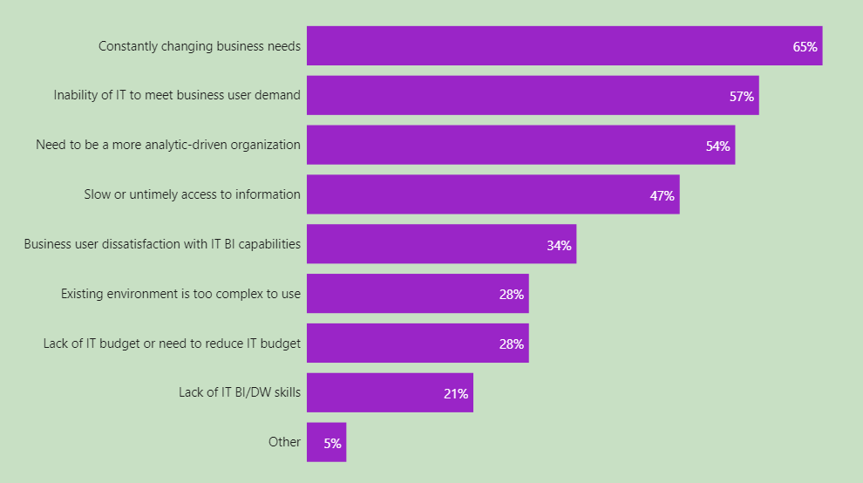
Why bother with Self-Service?
“If IT can’t satisfy users fast enough, the users will go around IT and create chaotic but quick BI solutions.”
“The inability to match the speed at which the business changes is a major impetus for SS BI”
“Timely access to crucial data means success!”
Data from an industry review of 587 respondents
Data and quotes from Imhoff C. & White C. (2011), “Self Service Business Intelligence”

Slide 8
Are there any risks?
Skills | Do we all have a citizen data scientist inside us?
Access | Can we democratize data without jeopardising security?
Redundancy | What if multiple people develop the same thing?
Decentralisation | Could we see multiple versions of the truth?
External Distribution | Can anyone publish anything?*
* Thanks to Nigel Davison for pointing this one out to me!

Slide 9
Demo time!

Slide 10
Conclusion
Self-Service is not a universal best approach
There will always be demand for guided analytics but it may become more niche
Hybrid models can offer flexibility to maximise positives and minimise risks
Industry trends will continue to move toward Self-Service
Trend in BI vendors to include these features is a good indication of what their customers are asking for
Role of data specialists will evolve to develop these tools
PowerBI is a great choice for building a Self-Service Platform!

Slide 11
Any Questions?

Slide 12
Further Reading
My blog posts this talk is based on (Sorry for the shameless self-promotion!) https://www.daytodatastuff.co.uk/blog/self-serve-analytics
https://www.daytodatastuff.co.uk/blog/self-service-analytics-the-practical
A link to the paper by Imhoff & White http://docs.media.bitpipe.com/io_10x/io_106625/item_583281/TDWI_Best_Practices_Report_Self-Service_BI_Q311%5B1%5D.pdf
A link to the paper by Caserio & Coelho
https://www.sciencedirect.com/science/article/pii/S2444569X18300374
Nigel Davison (BP) blog on SS v. GA
https://visualisation.data.blog/

